Slide 1

Mini Project (Id202b) Even Semester Session 2024-25
Ra One - Multiplayer Zombie Shooter Game
Project Supervisor:
Dr. Vipin Kumar

Slide 2

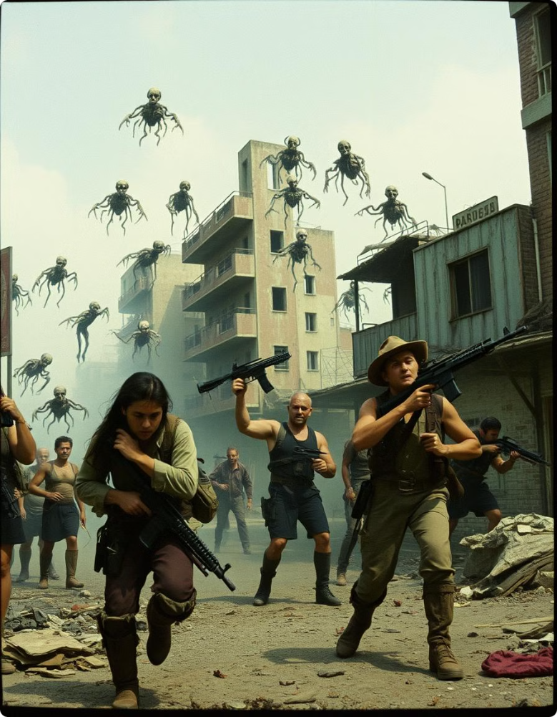
Ra One - Multiplayer Zombie Shooter Game
Presented by:
Shalendra Sharma
Shadab Idrishi
Rahul Pratap Singh Chauhan
Shalini Mishra
Notes:
Welcome everyone to our presentation on Ra One, a thrilling multiplayer zombie shooter game. I'm excited to share the key features and gameplay of this immersive post-apocalyptic experience. The game is set in a dilapidated city overrun by hordes of undead creatures, where a group of armed survivors must band together to fight for their lives. The intense, fast-paced combat and strategic team play create an adrenaline-pumping challenge for players. We'll dive into the game's unique mechanics, diverse character classes, and customization options that allow you to tailor your playstyle. Get ready to be transported to a gritty, atmospheric world where your survival skills will be put to the test.

Slide 3
Project Overview
Gameplay
What is Ra One?
A Java-based multiplayer zombie shooter game. Players compete to eliminate zombies and earn the highest score.
The player with the most kills wins the match. Aligned with SDG 16 (Peace, Justice & Strong Institutions) to promote fair play.

Slide 4
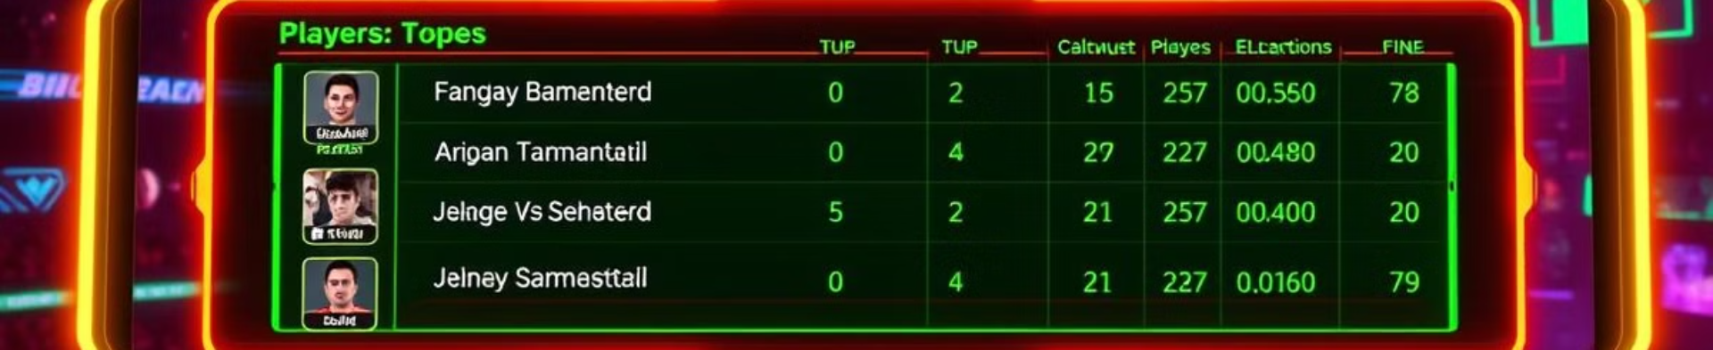
Game Concept & Features
100+ Zombies
Real-time Gameplay
Engaging UI
Randomly spawn per match. Players use weapons to shoot zombies and earn points.
Real-time movement & collision detection. Leaderboard system to track high scores.
Using Java Swing and AWT to create an immersive user interface.

Slide 5
Game Modules
Zombie AI Module
Bullet Mechanics
Player Module
. Handles zombie movements and attacks on players
Manages shooting logic and collision detection.
Controls player movement, shooting, and interactions.
Score & Leaderboard
Game Environment
Tracks player kills & rankings.
Handles background, UI design, and event interactions.

Slide 6
SDG 16 - Fair Play & Ethics in Gaming
Fair Competition
Ethical Game Design
Encourages fair competition in multiplayer mode. Players need to strategize & improve teamwork.
Uses ethical game design principles for fair play. Creates an immersive gaming experience for all players.

Slide 7





Technology Stack
Java
Java Swing
Java AWT
Java Networking
Programming Language
GUI Framework
Graphics & Event Handling
Multiplayer Integration (Future Work)
Java Collections
Game Logic Management

Slide 8
Workflow / Game Flow
Game Start
1
Players join a multiplayer session.
2
Zombie Spawning
AI spawns zombies randomly.
Player Interaction
3
Players shoot zombies and earn points.
4
Scoreboard Updates
Scores update in real time.
Game End
5
The player with the highest zombie kills wins the match.

Slide 9
Challenges Faced & Solutions
Challenges
Solutions
Additional Challenges
Additional Solutions
Real-time collision detection & movement. Implementing an efficient AI for zombies.
Used Java AWT & Swing for optimized rendering. Improved zombie pathfinding for better gameplay.
Managing smooth gameplay without lag.
. Implemented efficient memory management techniques

Slide 10



Conclusion & Future Scope
Ra One
1
A thrilling zombie shooter game with engaging mechanics.
Fair Competition
2
Promotes fair competition & player engagement.
Java Technologies
3
Uses Java technologies to create a smooth gaming experience.
Future Enhancements: Implementing multiplayer network-based battles, enhancing AI for more challenging zombie behaviors, expanding to mobile & web-based platforms.

Slide 11

References
Java Swing & AWT Official Documentation, Game Development Articles on Java, AI Pathfinding Techniques for NPCs.
Notes:
• The "References" slide provides a curated list of key resources for learning more about Java Swing and AWT, game development with Java, and AI pathfinding techniques. • These topics are all highly relevant to the overall presentation, and the references offered serve as a great starting point for further exploration and skill development. • The official Java Swing and AWT documentation is an essential resource for understanding the core UI frameworks. The game development articles offer practical, hands-on guidance. And the AI pathfinding techniques are crucial for building engaging, intelligent game experiences. • Together, these references cover a breadth of Java-related knowledge, from foundational concepts to advanced applications. Encouraging the audience to explore these resources will empower them to continue learning and growing their Java expertise beyond this presentation. • I've suggested adding some visuals to this slide, like cover images of the documentation or sample game screenshots, to help illustrate the types of content available in these references.

Slide 12


Notes:
• The "References" slide provides a curated list of key resources for learning more about Java Swing and AWT, game development with Java, and AI pathfinding techniques. • These topics are all highly relevant to the overall presentation, and the references offered serve as a great starting point for further exploration and skill development. • The official Java Swing and AWT documentation is an essential resource for understanding the core UI frameworks. The game development articles offer practical, hands-on guidance. And the AI pathfinding techniques are crucial for building engaging, intelligent game experiences. • Together, these references cover a breadth of Java-related knowledge, from foundational concepts to advanced applications. Encouraging the audience to explore these resources will empower them to continue learning and growing their Java expertise beyond this presentation. • I've suggested adding some visuals to this slide, like cover images of the documentation or sample game screenshots, to help illustrate the types of content available in these references.

